Slide 1


C-Games
#include <fun.h>
int main ( )
{
/*
where fun begins;
Just play and relax;
*/
}
return 0;

Slide 2

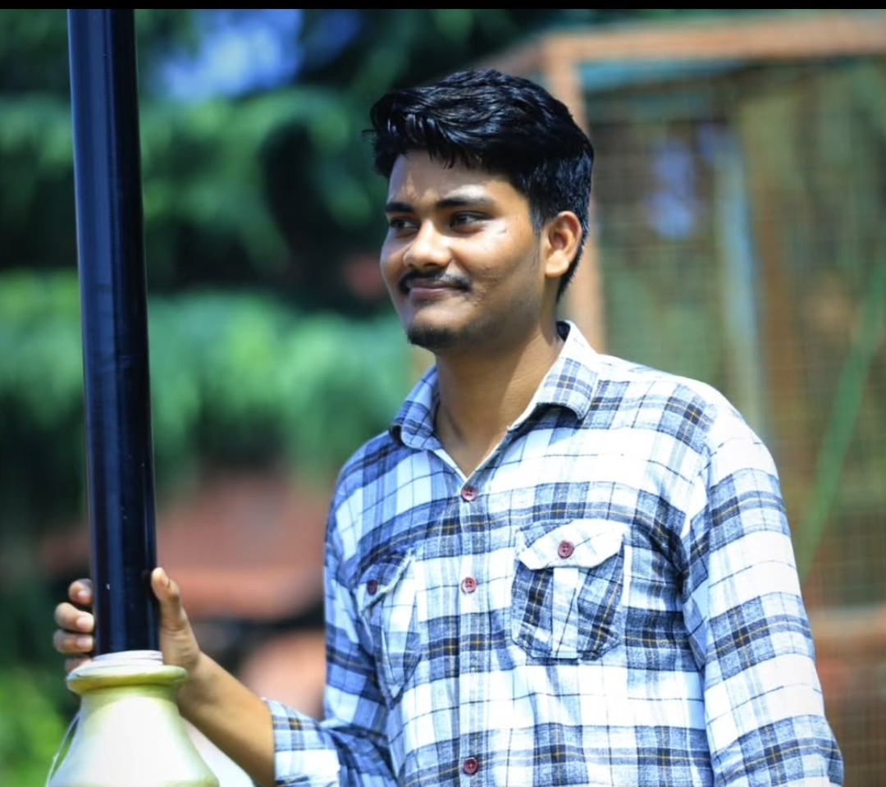

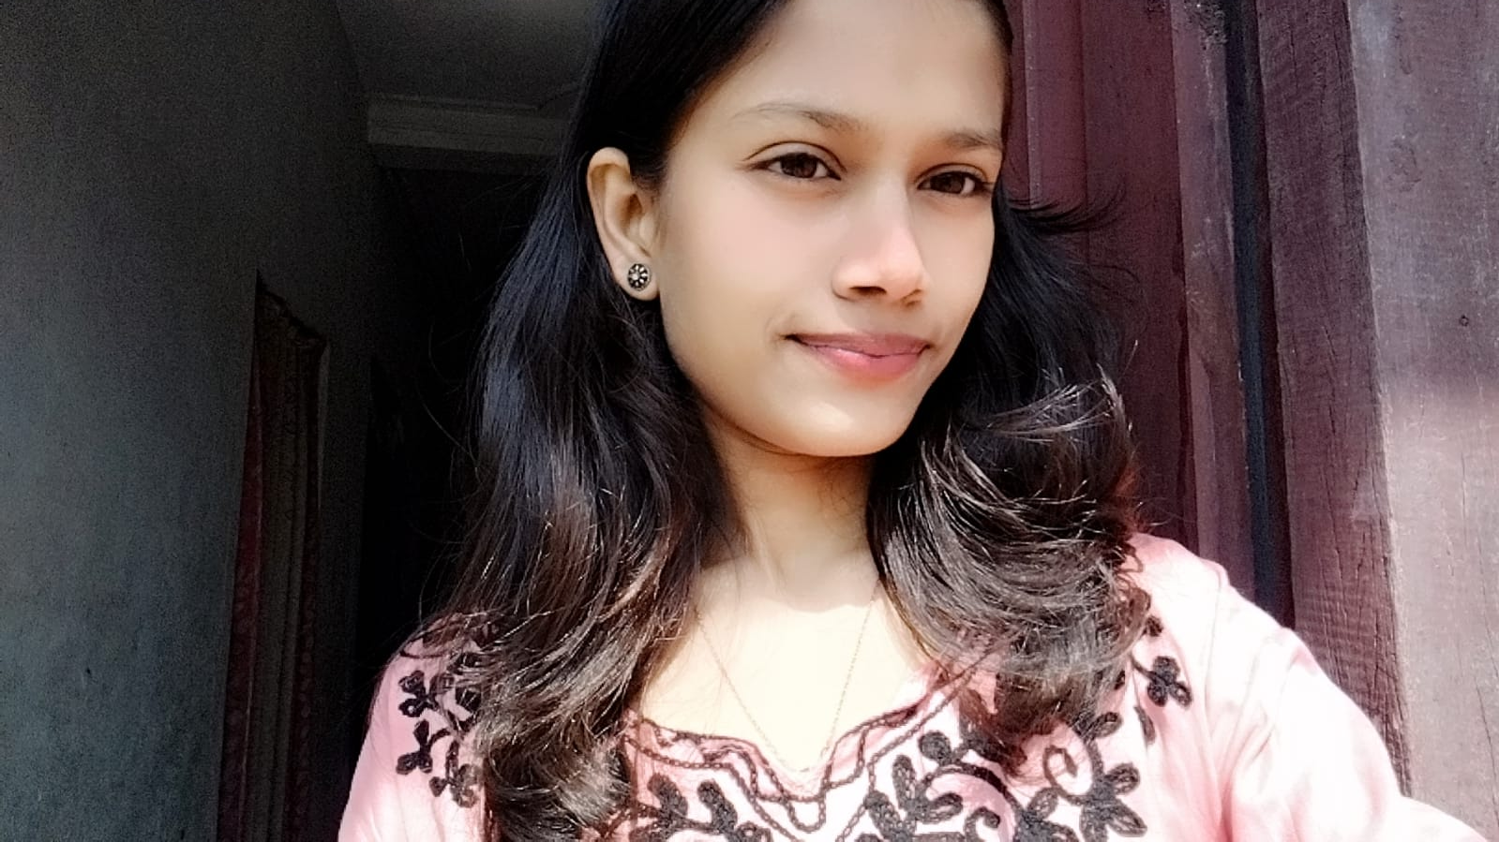
Team Members
Sagun Kumar Bhagat
Rakesh Kumar Mehta
Sachita Yadav
Samiksha Singh
PUR-081-BCT-067
PUR-081-BCT-056
PUR-081-BCT-065
PUR-081-BCT-070

Slide 3
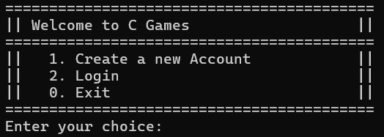
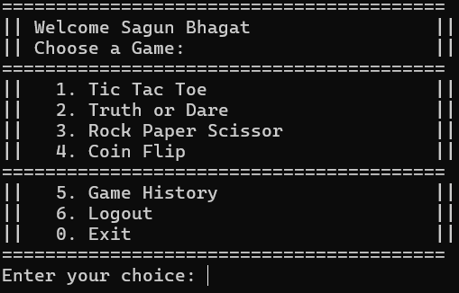
INTRODUCTION
Welcome to C Games - a hub of entertainment and excitement! With a seamless login system and a variety of captivating games, you are in for a delightful gaming experience. Get ready to embark on a thrilling journey of fun and games! Let's dive in!

Slide 4
FEATURES OF THE C-Games
Authentication
Games
History Tracking
Account creation and login system
Collection of 4 console based games
Track the games you played with score and date

Slide 5

Rock Paper Scissor
"Rock Paper Scissors" game where you compete against the computer. Choose 'r' (rock), 'p' (paper), or 's' (scissors), and see who wins! Play multiple rounds or quit with 'q'. Simple and fun!

Slide 6
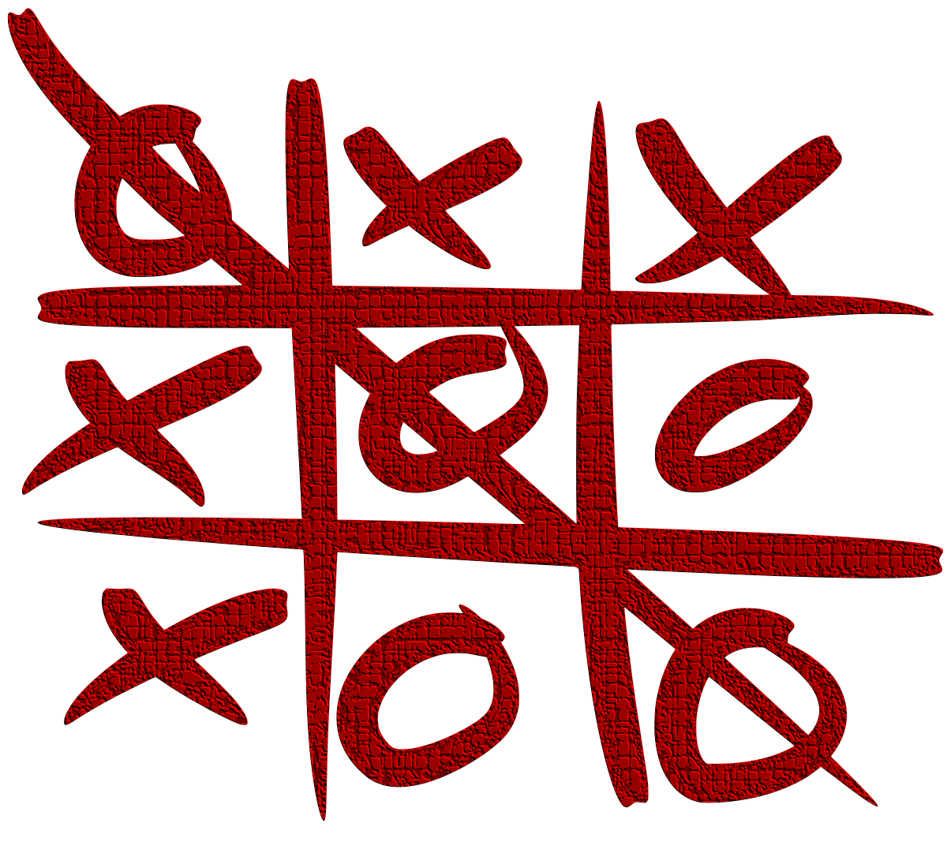
Tic Tac Toe
"Tic Tac Toe" is a classic two-player game where each player takes turns marking a cell in a 3x3 grid. The goal is to place three marks in a row horizontally, vertically, or diagonally to win. The game continues until a player wins or it's a draw. Enjoy the timeless fun of "Tic Tac Toe"!

Slide 7

Truth or Dare
"Truth or Dare" is a multiplayer party game, where players take turns selecting either truth questions or dares. Players earn points for successfully completing their chosen task. The player with the highest score at the end wins.

Slide 8

Coin Flip
"Coin Flip" is a single-player game where you guess if a virtual coin will land on heads or tails. Get it right, and you earn a point; get it wrong, and you lose one. Enter 'h' for heads, 't' for tails, or 'q' to quit. Simple and fun!

Slide 9

The Challenges & Lessons Learned
Debugging
Debugging complex game logic presented significant challenges.
Input Handling
We learned to effectively handle user input errors and prevent program crashes.
Performance Optimization
We prioritized optimizing performance to ensure smooth and responsive gameplay.

Slide 10
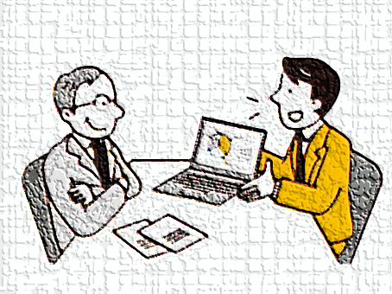
LIVE DEMONSTRATION
Effective more than thousand words of explanation………….

Slide 11
THANKS!

